Slide 1
Comparative Genomics Databases
Presented by Kunal
M.Sc. Bioinformatics 3rd sem
BI-304

Slide 2
COG
The database of Clusters of Orthologous Groups of proteins (COGs) is an attempt on a phylogenetic classification of the proteins encoded in 21 complete genomes of bacteria, archaea and eukaryotes.
The COGs were constructed by applying the criterion of consistency of genome-specific best hits to the results of an exhaustive comparison of all protein sequences from these genomes.
Application of COG:
The most straightforward application of the COGs is for the prediction of functions of individual proteins or protein sets, including those from newly completed genomes.

Slide 3
VirGen
VirGen is a comprehensive viral genome resource that has been developed with the objective of serving as an annotated and curated database comprising complete genome sequences of viruses, value-added derived data and data mining tools
A well-annotated genome record, in consistency with ICTV is identified as a 'representative entry' for every viral species.
It is the first resource to provide phylogenetic trees of viral species computed using whole-genome sequence data.
The module of predicted B-cell antigenic determinants in VirGen is an attempt to link the genome to its vaccinome.
Comparative genome analysis data facilitate the study of genome organization and evolution of viruses, which would have implications in applied research to identify candidates for the design of vaccines and antiviral drugs.

Slide 4
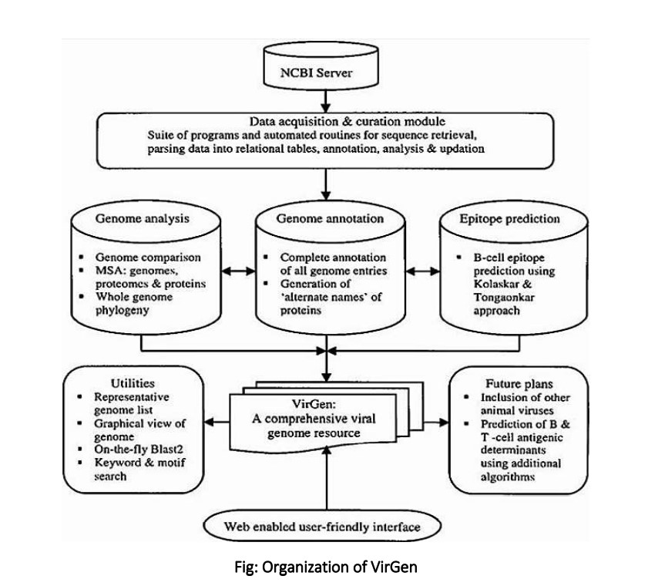

Slide 5
CORG
the CORG—‘COmparative Regulatory Genomics’
CORG data are accessible from the ENSEMBL web site via a DAS service as well as a specially developed web service (http://corg.molgen.mpg.de) for query and interactive visualization of the conserved blocks and their annotation.
The COmparative Regulatory Genomics (CORG) database and annotation project aims at providing insights into gene regulation at the level of transcription.
The CORG project provides a catalogue of non-coding blocks of DNA sequence conserved between orthologous genes of man and mouse. It is based on a comprehensive, genome-wide computational analysis

Slide 6
HOBACGEN: (Homologous Bacterial Genes Database)
HOBACGEN has been now replaced by the HOGENOM database. HOGENOM contains data from all complete genomes, including of course bacteria and archaea. The HOBACGEN database is therefore no longer maintained.)
It allows one to select sets of homologous genes from bacterial species and to visualize multiple alignments and phylogenetic trees. Thus HOBACGEN is particularly useful for comparative genomics, phylogeny and molecular evolution studies on bacteria.
The database contains all sequences of bacteria (eubacteria and archeae) and yeast taken from SWISSPROT + TrEMBL,(now the UniProt Knowledgebase) with some annotation modifications
NOTE- HOBACGEN contains the protein sequences from SWISS-PROT + TrEMBL (now the UniProt Knowledgebase) while HOBACCGENDNA contains the nucleotide sequences from EMBL.

Slide 7
Homophila: human disease gene cognates in Drosophila
At the Homophila database Web site, human genes, fly genes, and diseases are cross-referenced and linked, for instance, to scientific abstracts and to a catalogue of genetic conditions called OMIM (Online Mendelian Inheritance in Man).
The organization of human and fly data and the analysis by Potocki suggested that there are fly counterpart genes for human conditions like blindness, deafness, blood disorders, and immunological disorders.

Slide 8
XREFdb: cross-referencing the genetics and genes of mammals and model organisms
XREFdb provides a TBLASTN search feature that accepts protein query sequences and compares them with a current six-frame translation of the Database of Expressed Sequence Tags (dbEST; 2, 3) maintained at the NCBI. In the past, XREFdb has been organized in an accountholder format, with periodic whole database updates . However, a new search service within XREFdb is designed to provide users with current information on-the-fly.
XREFdb supports the investigation of protein function in the context of information available through work in multiple organisms. In addition to facilitating the association of functional data among known genes from multiple organisms, XREFdb has developed strategies that provide access to information associated with as-yet unstudied genes. The database organizes protein similarity and genetic map positional information from diverse sources in the public domain to facilitate investigator evaluation of potential functional signifi-cance. XREFdb is found at URL www.ncbi.nlm.nih. gov/XREFdb

Slide 9
Gramene
Gramene (http://www.gramene.org) is an online, open source, curated resource for plant comparative genomics and pathway analysis designed to support researchers working in plant genomics, breeding, evolutionary biology, system biology, and metabolic engineering.
It consists of an integrated portal for querying, visualizing and analyzing data for 44 plant reference genomes, genetic variation data sets for 12 species, expression data for 16 species, curated rice pathways and orthology-based pathway projections for 66 plant species including various crops.
Note- Gramene (http://www.gramene.org) supports researchers working with various crops, models, and other economically important plant species by providing online resources for comparative analyses of Genomes and Pathways [1], [2]. The Genomes portal, developed collaboratively with Ensembl Plants.

Slide 10
Single Nucleotide Polymorphism, dbSNP and other SNP-related databases
Website: www.ncbi.nlm.nih.gov/projects/SNP/ )
Developed and hosted by the National Center for Biotechnology Information (NCBI) in collaboration with the National Human Genome Research Institute (NHGRI).
the name of the database implies a collection of one class of polymorphisms only (i.e., single nucleotide polymorphisms (SNPs)), it in fact contains a range of molecular variation: SNPs, short deletion and insertion polymorphisms (indels/DIPs), microsatellite markers or short tandem repeats (STRs), multinucleotide polymorphisms (MNPs), heterozygous sequences, and named variants.
As of build 131 (available February 2010), dbSNP had amassed over 184 million submissions representing more than 64 million distinct variants for 55 organisms, including Homo sapiens, Mus musculus, Oryza sativa, and many other species. NCBI will phase out support for all non-human organisms in dbSNP and dbVar during 2017.

Slide 11
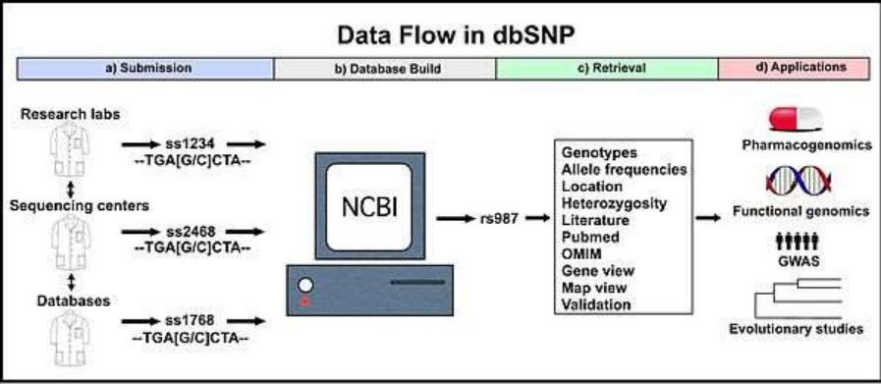

Slide 12
Purpose -
Its goal is to act as a single database that contains all identified genetic variation, which can be used to investigate a wide variety of genetically based natural phenomenon.
Specifically, access to the molecular variation cataloged within dbSNP aids basic research such as physical mapping, population genetics, investigations into evolutionary relationships, as well as being able to quickly and easily quantify the amount of variation at a given site of interest. In addition, dbSNP guides applied research in pharmacogenomics and the association of genetic variation with phenotypic traits.[4] According to the NCBI website, “The long-term investment in such novel and exciting research [dbSNP] promises not only to advance human biology but to revolutionise the practice of modern medicine.”

Slide 13
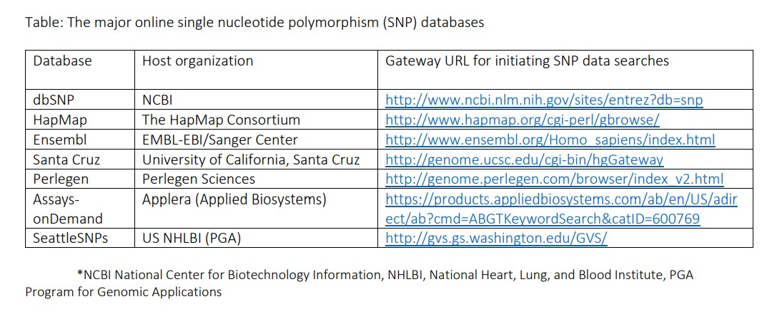

Slide 14
Pharmacogenomics
Pharmacogenomics is the study of the role of the genome in drug response. Its name (pharmaco- + genomics) reflects its combining of pharmacology and genomics.
Pharmacogenomics analyzes how the genetic makeup of an individual affects his/her response to drugs. It deals with the influence of acquired and inherited genetic variation on drug response in patients by correlating gene expression or single-nucleotide polymorphisms with pharmacokinetics (drug absorption, distribution, metabolism, and elimination) and pharmacodynamics (effects mediated through a drug's biological targets).
, pharmacogenetics focuses on single drug-gene interactions, while pharmacogenomics encompasses a more genome-wide association approach, incorporating genomics and epigenetics while dealing with the effects of multiple genes on drug response.

Slide 15
More details about Pharmacogenomics
There may be several reasons that influence variability in drug responses between patients e.g. Drug-drug interactions, drug-food interactions, sex, age, disease state pregnancy etc.
Note- Genetic factors are also likely to play a major role in individual drug response.
There are several challenges to implementing pharmacogenomic testing in clinical practice i.e. • the Lack of readily available resources, • feasibility and utility • level of evidence, • provider knowledge, • cost effectiveness, and • ethical, legal, and social issues
The genes that are more widely accepted and utilized clinically to get some conclusion are: • Cytochrome P450s • VKORC1 • TPMT

Slide 16
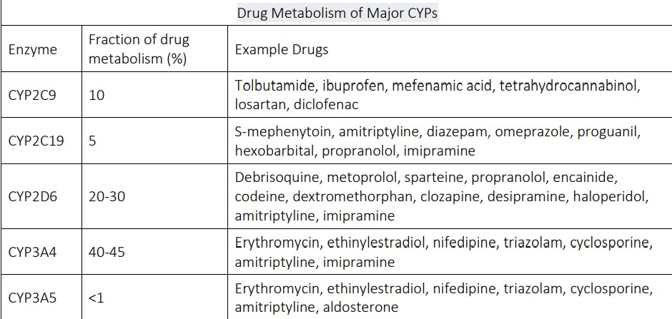

Slide 17
Open to questions

